Slide 1
Bacchus Winery Case Study
Charlie Team

Slide 2
Overview
Group Intro
Description of case study
Group ORD
Supplier Report & Report Description
Distributor Report & Report Description
Employee Report & Report Description
Summary
Note: Separate reports will include respective assumptions

Slide 3
Charlie Team Members
Grace Steranko
San Angelo, Texas
Wendy Rodriguez
San Diego, California
Tim Alvarado
Bellevue, Nebraska
Nicholas Constentino

Slide 4
Bacchus Winery Brief Overview
Stan and Davis Bacchus inherited Bacchus Winery from their father, George Bacchus. The winery grows the grapes needed for their wines. The company makes a Merlot, a Cabernet, a Chablis and a Chardonnay. The 3 main suppliers provide production supplies to the company on a monthly basis. The company also has 6 main employees who all make up the backbone of the company.
The following questions needs to be answered in the “yearly snapshot” of the company at a big upcoming meeting:
Are all suppliers delivering on time?
Is there a large gap between expected delivery and actual delivery?
Are all wines selling as they thought?
Is one wine not selling?
Which distributor carries which wine?
During the last four quarters, how many hours did each employee work?

Slide 5



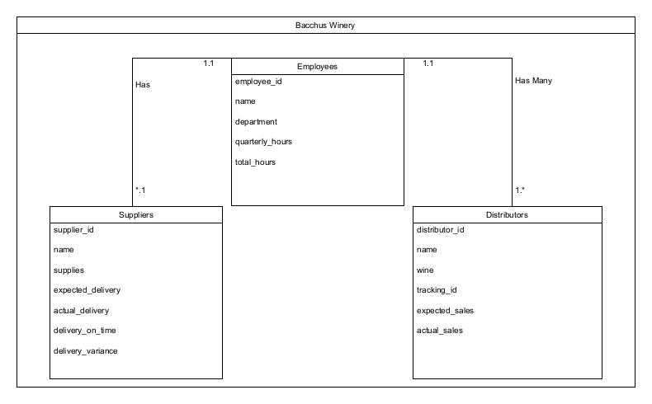


Group ORD

Slide 6
Supplier Report Description
Report displays:
Monthly expected and actual delivery date for each supplier for the last 6 months
Assumptions made:
Each supplier makes only one delivery per month
All supplies that they provide are delivered during that delivery.
The winery has enough supplies left over to keep production going in the event of late deliveries.
On-time delivery would be measured by the actual delivery date being within 4 days of the expected delivery date.
Data shows:
Corks R Us: Regularly makes their deliveries at least two weeks late
Delivered on-time once
Percentage of late deliveries : 83%
Percentage of on-time deliveries: 17%
Printers and Stuff: deliveries are routinely on-time
Percentage of on time-deliveries: 100%
Sampson Supplies
Percentage of on-time deliveries: 100%
Some deliveries even received early
It can be determined that Bacchus Winery should be looking at alternative supply options for their bottles and corks that are used for production.

Slide 7
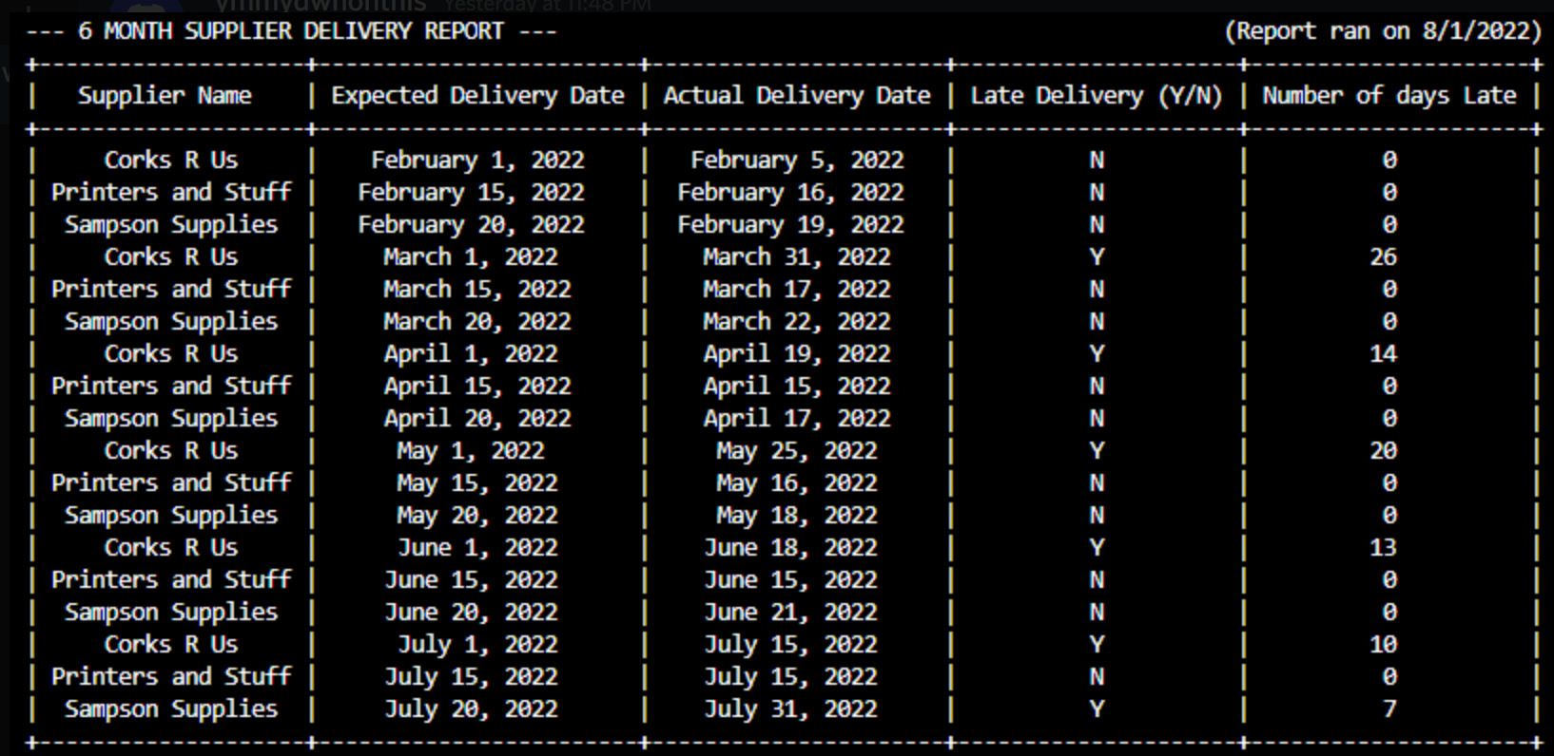
Supplier Report Output

Slide 8
Distributor Report Description
Report displays:
Expected sales in barrels vs. actual sales
List of how many distributors carry each wine
List of distributors and which wine they carry
Assumptions made:
Chardonnay is the top seller is because the grapes used for wines like Merlot, and Cabernet were mostly destroyed during a wildfire and were not available for wider distribution.
In the future, it is also expected that more than one wine will be carried by each distributor.
Chablis wine is imported from a sister winery in France and is only being distributed by one company now.
May have to be discontinued in the future if the cost of importing it gets to be too much for Bacchus Winery.
Data shows:
The winery’s top selling wine : Chardonnay
Selling more than expected
Other wines are not selling as expected (likely due aforementioned fires)

Slide 9
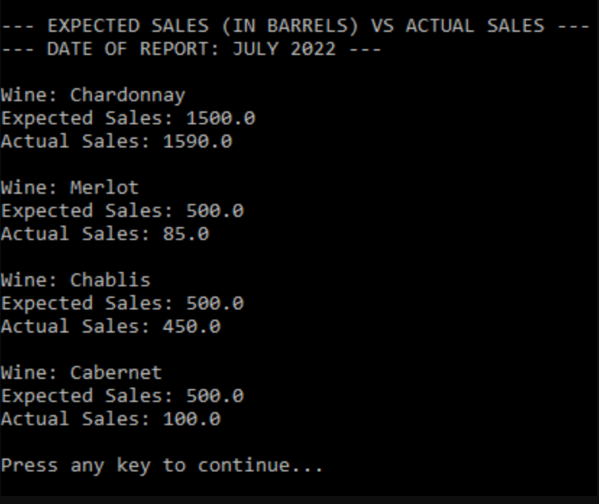
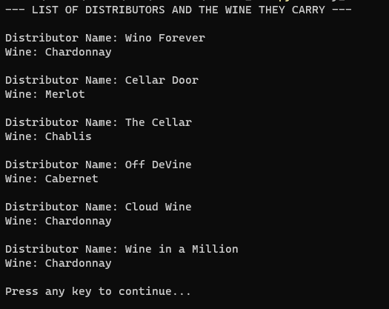
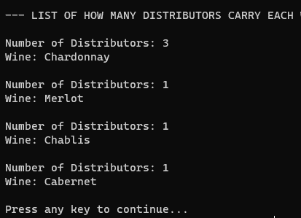
Distributor Report Output

Slide 10
Employee Report Description
Report displays:
Logged hours for 6 of the employees of Bacchus Winery
Total number of hours worked for the last 4 quarters for each employee
Assumptions made:
Each employee that we chose had worked during every quarter and did not take any extended vacations during those periods of time.
Company had an established baseline for what constitutes as an employee working a “full” hour, therefore making it feasible to put them all in the same table.
Data shows:
Janet Collins worked 1650 hours in total over the last 4 quarters.
•Roz Murphy worked 1725 hours over the last 4 quarters.
•Bob Ulrich worked 1665 hours over the last 4 quarters.
•Henry Doyle worked 1710 hours over the last 4 quarters.
•Maria Costanza worked 1720 hours over the last 4 quarters.
•Stan Bacchus worked 1837 hours over the last 4 quarters.
The main players of the company have all worked very comparable hours which is integral for running a sustainable business.

Slide 11
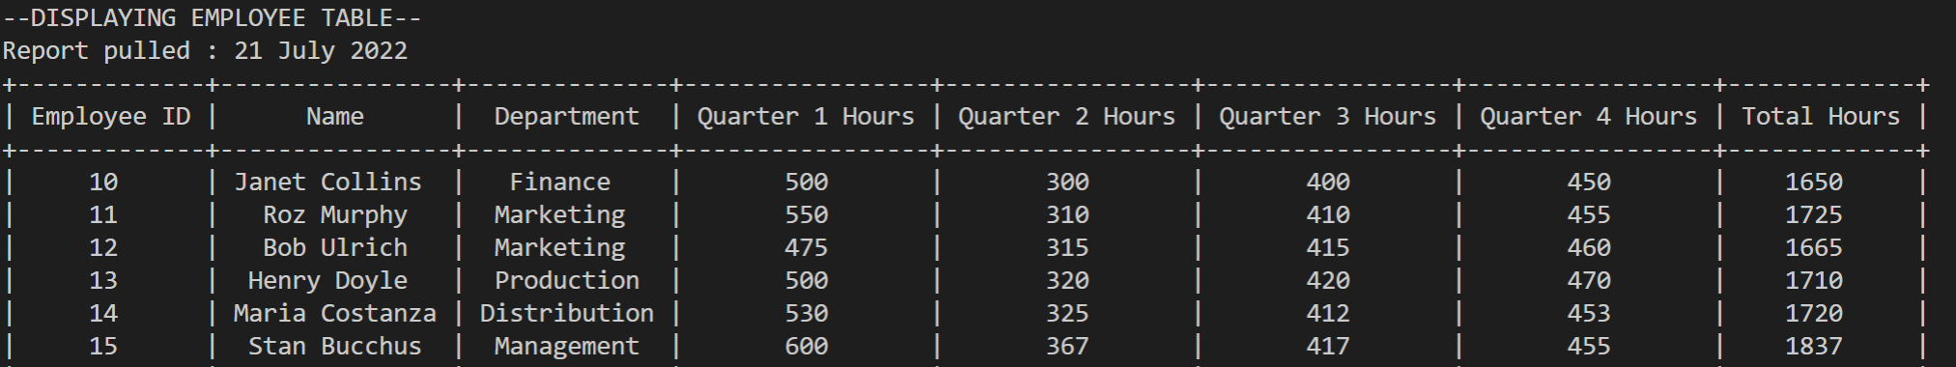
Employee Report Outputs

Slide 12
Summary
Bacchus Winery is a flowering business with a menagerie of moving parts.
When it comes to suppliers, it has been determined that Bacchus Winery should be looking elsewhere for a more reliable cork and bottle source.
Distributor data shows that not all wine is selling as expected, but with good reason. Each distributor only sells one wine, but that could change in the future.
All 6 main employees of Bacchus Winery have worked comparable hours in the past 4 quarters.
As far as the yearly “snapshot” goes, we think Bacchus Winery is running a sustainable business model and now has a clear path forward thanks to the reports we ran.

Slide 13
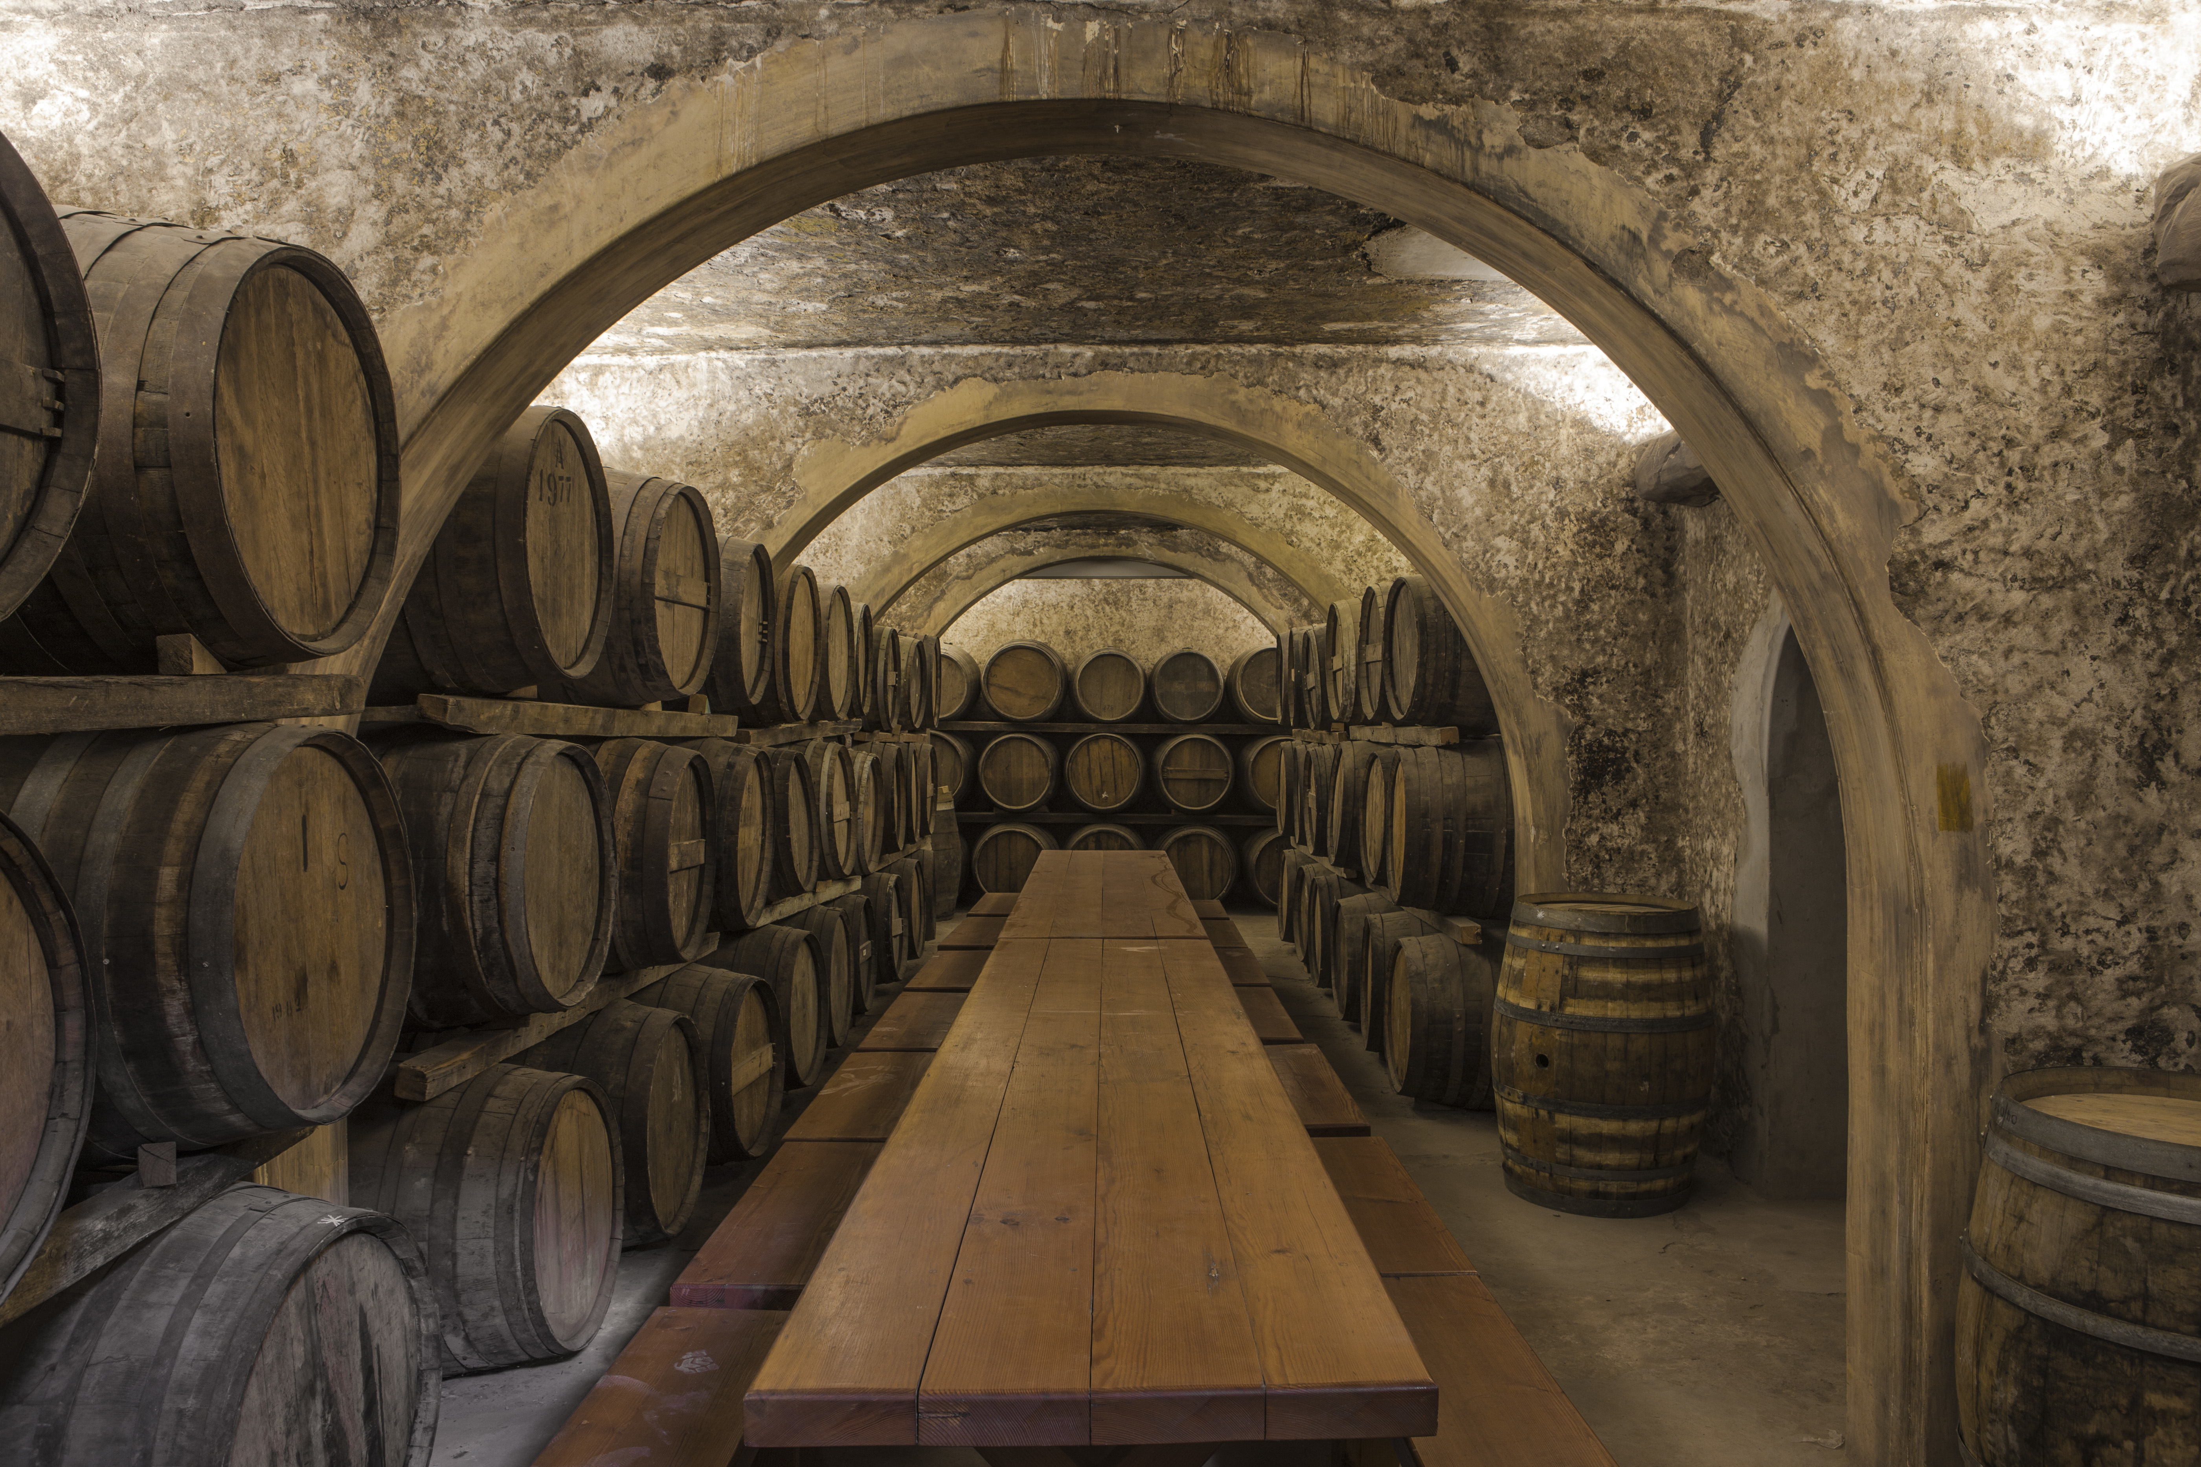
The End

